Slide 1


Slide 2
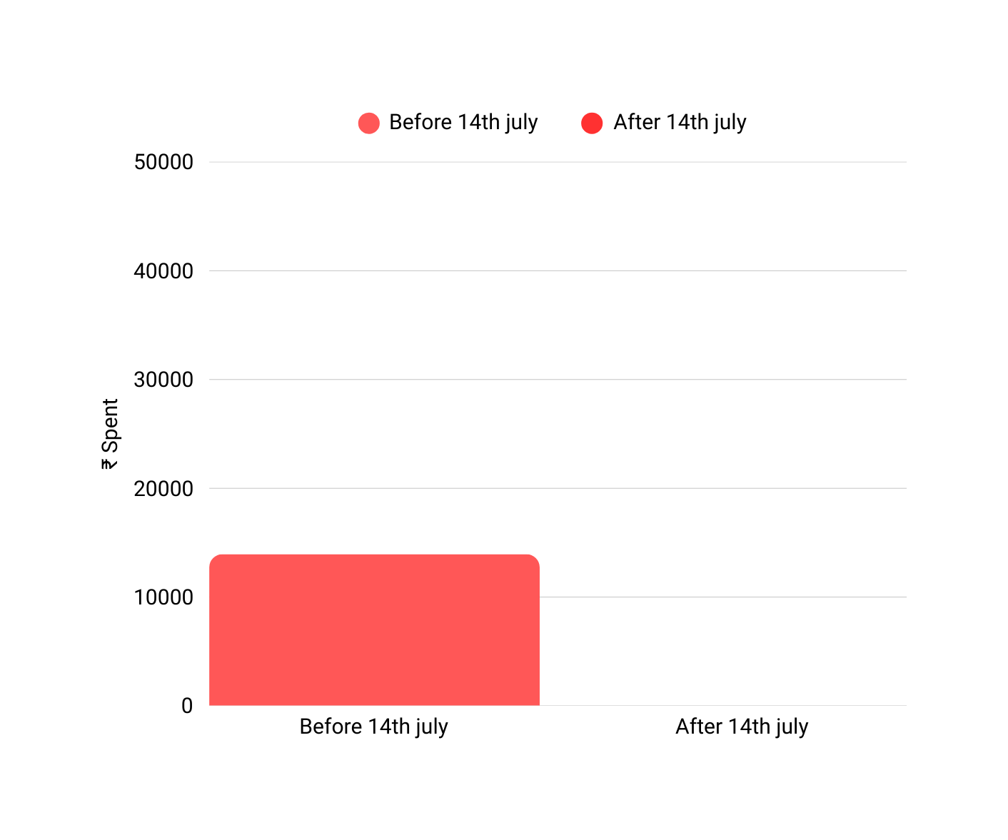
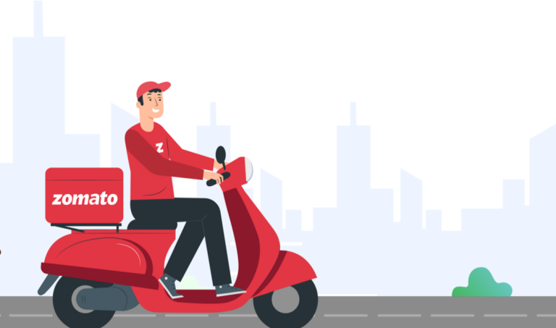

Slide 3
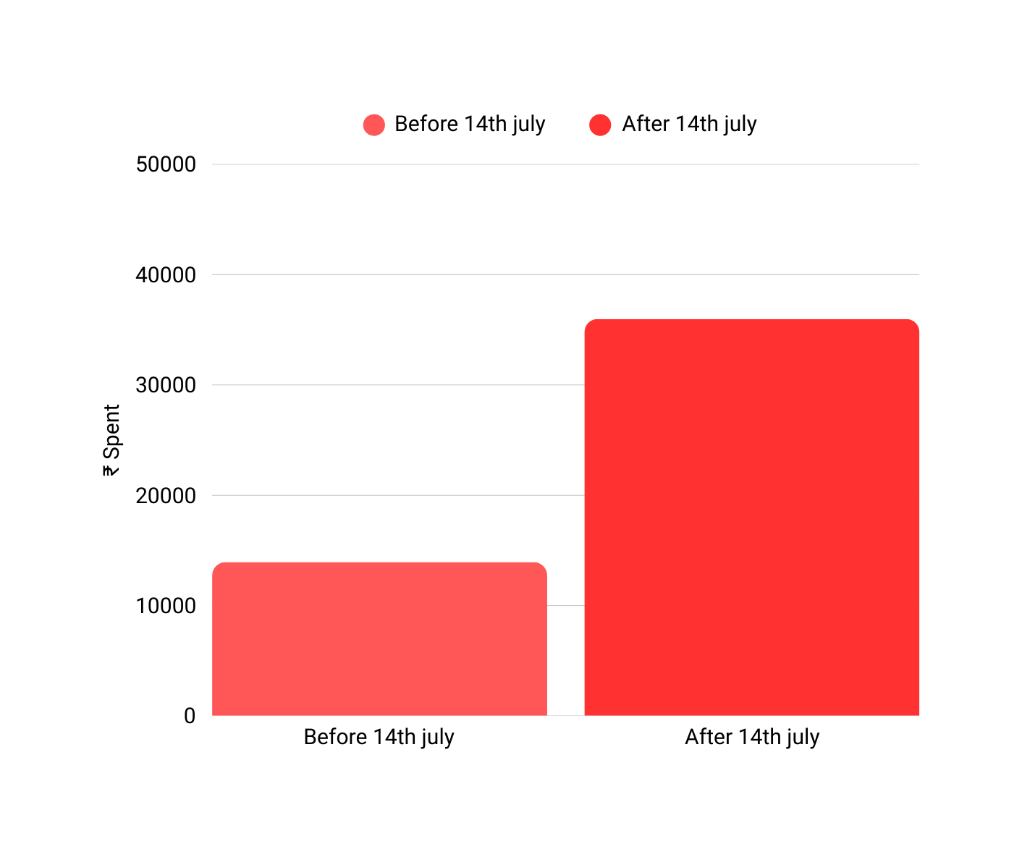

Slide 4
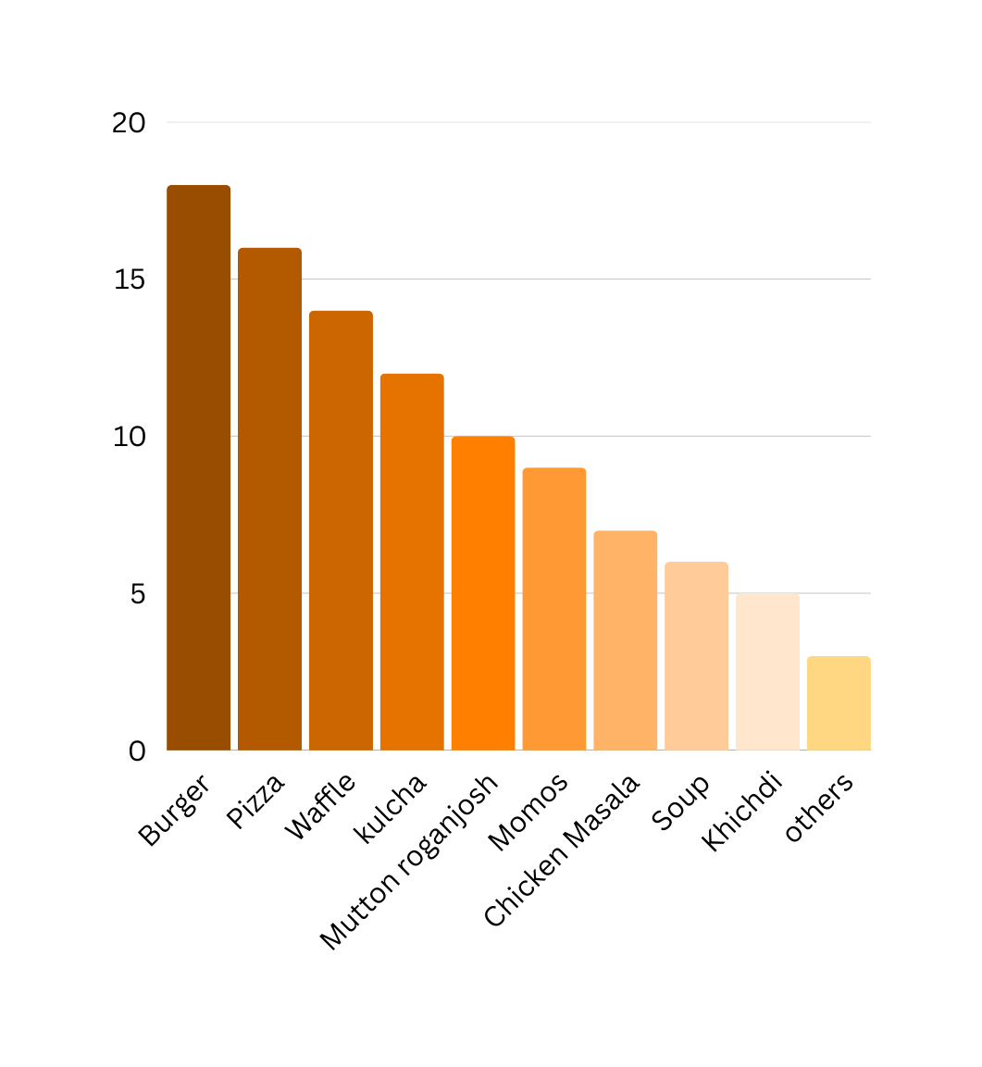


Order summary(in %)

Slide 5
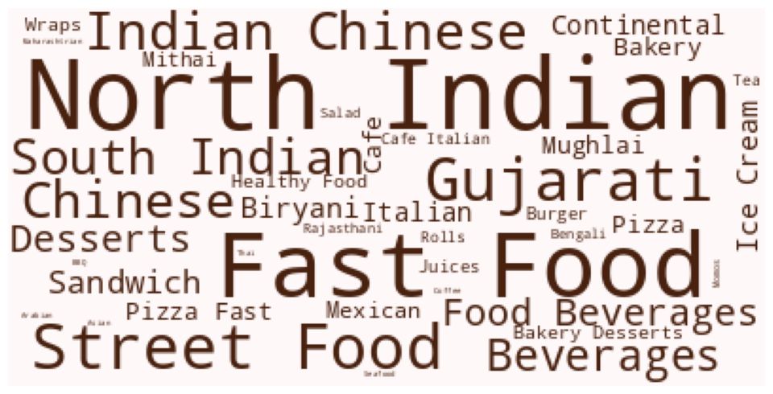
Gandhinagar

Slide 6
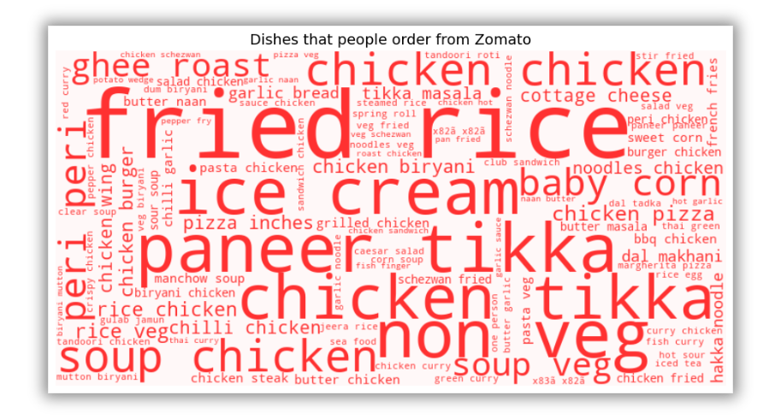
Bangalore
Source : https://www.kaggle.com/datasets/himanshupoddar/zomato-bangalore-restaurants

Slide 7
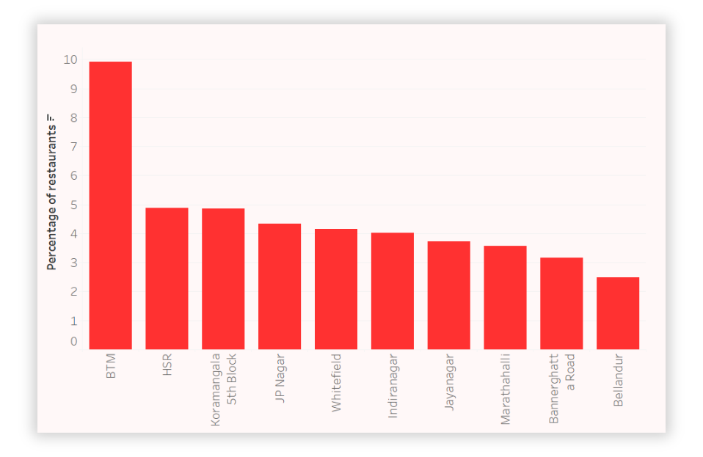
Bangalore
Top localities by restaurant presence
Source : https://www.kaggle.com/datasets/himanshupoddar/zomato-bangalore-restaurants

Slide 8
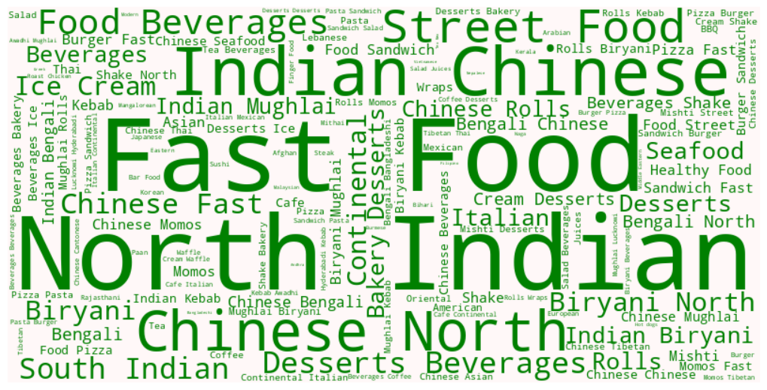
Kolkata
Source : https://www.kaggle.com/datasets/vora1011/zomato-kolkata-restaurants-2022

Slide 9
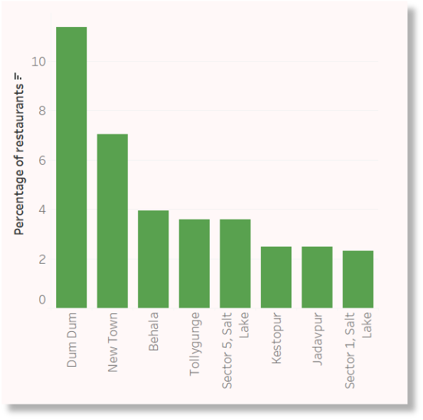
Top localities by restaurant presence

Slide 10
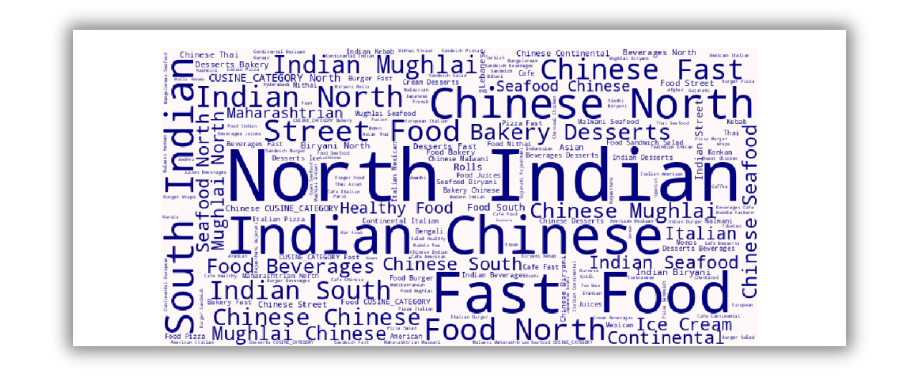
Mumbai
Source : https://www.kaggle.com/datasets/sleepyowl007/zomato-mumbai-dataset/data

Slide 11
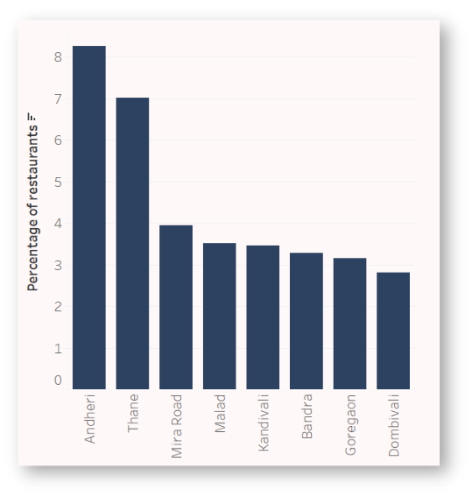
Top localities by restaurant presence

Slide 12

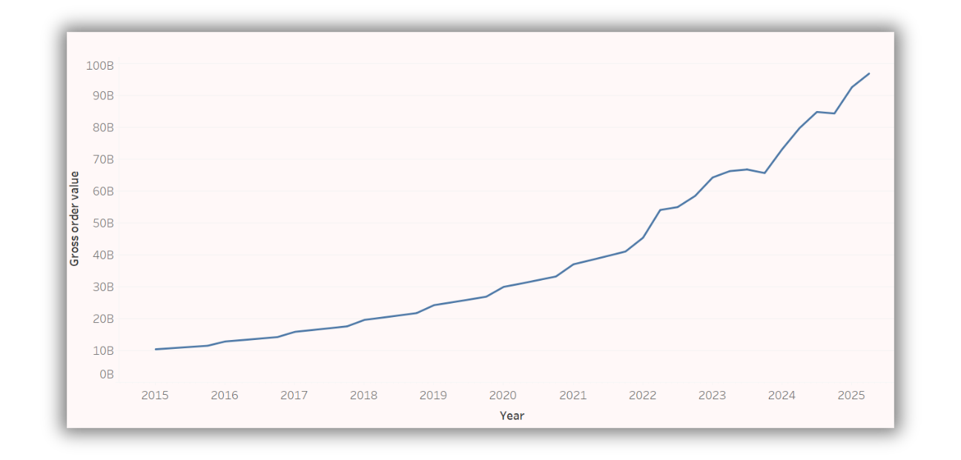

Zomato’s financials over the years
Gross order value

Slide 13

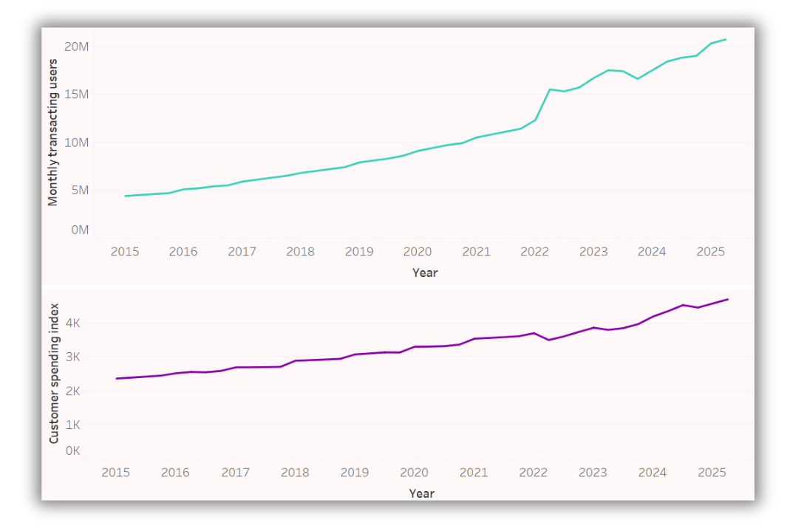
Zomato’s financials over the years

Slide 14
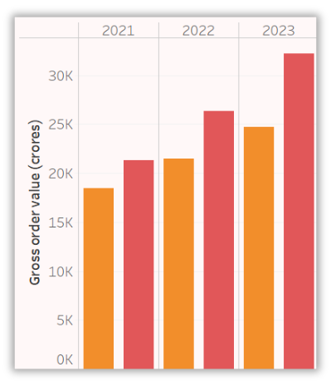
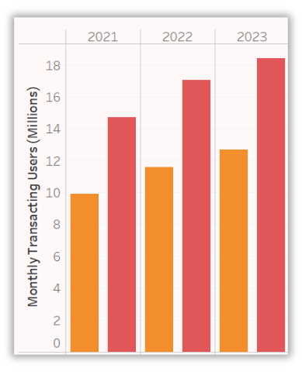
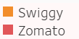
Zomato & Swiggy : financials
Source : https://www.swiggy.com/corporate/investor-relations/financial-results/
https://www.eternal.com/investor-relations/results/

Slide 15
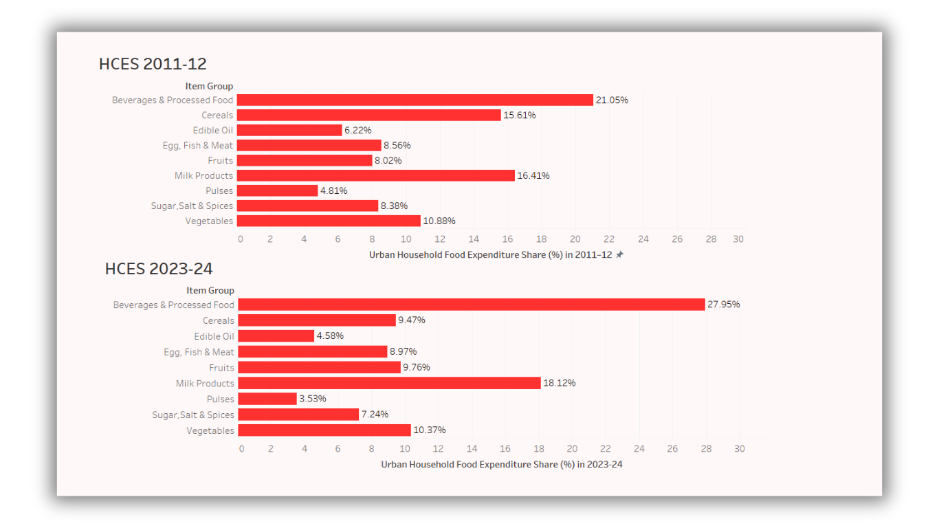
Household expenditure report
Source : HCES
*preprocessed food includes purchased cooked meals

Slide 16
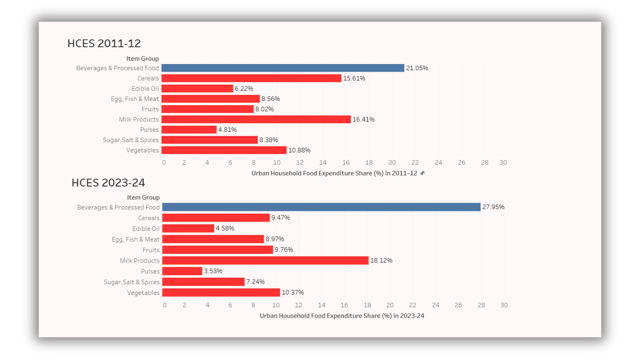
Household expenditure report
Source : HCES
*preprocessed food includes purchased cooked meals

Slide 17
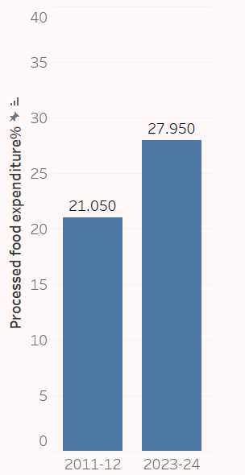

≈32.78%

Slide 18
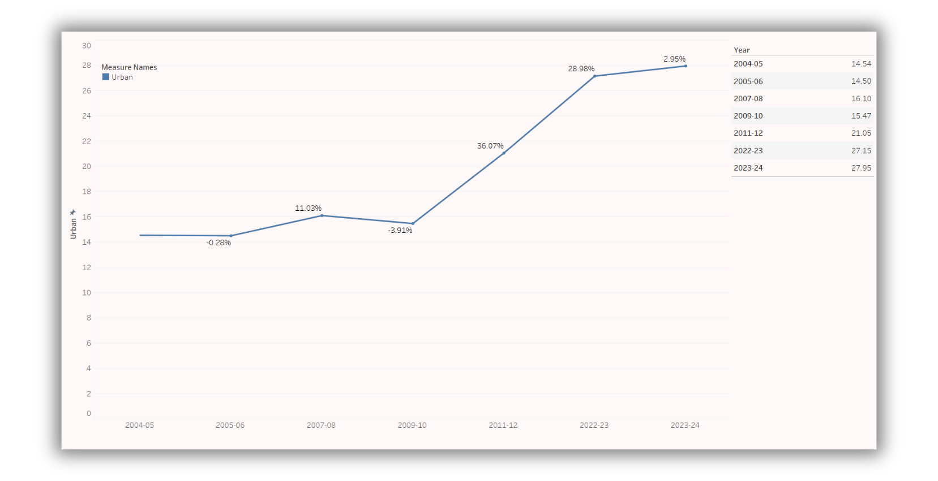
Growth in expenditure of preprocessed food : Urban
Source : HCES

Slide 19
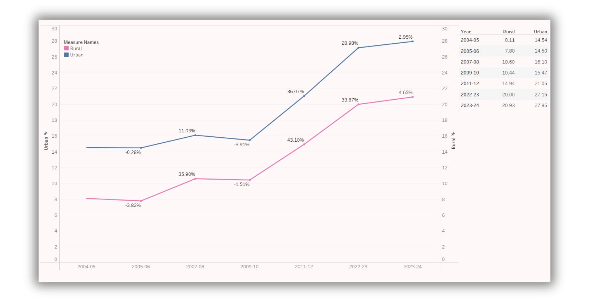
Growth in expenditure of preprocessed food : Urban & Rural
Source : HCES

Slide 20
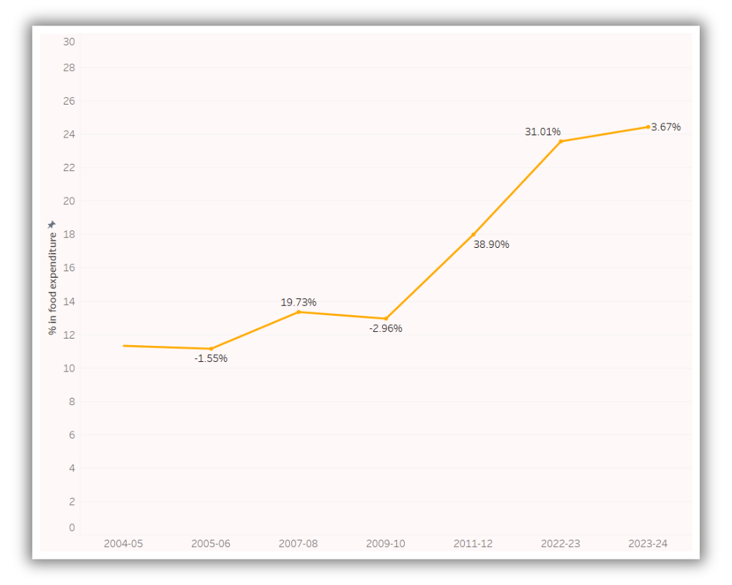
Growth in expenditure of preprocessed food : Overall
Source : HCES

Slide 21
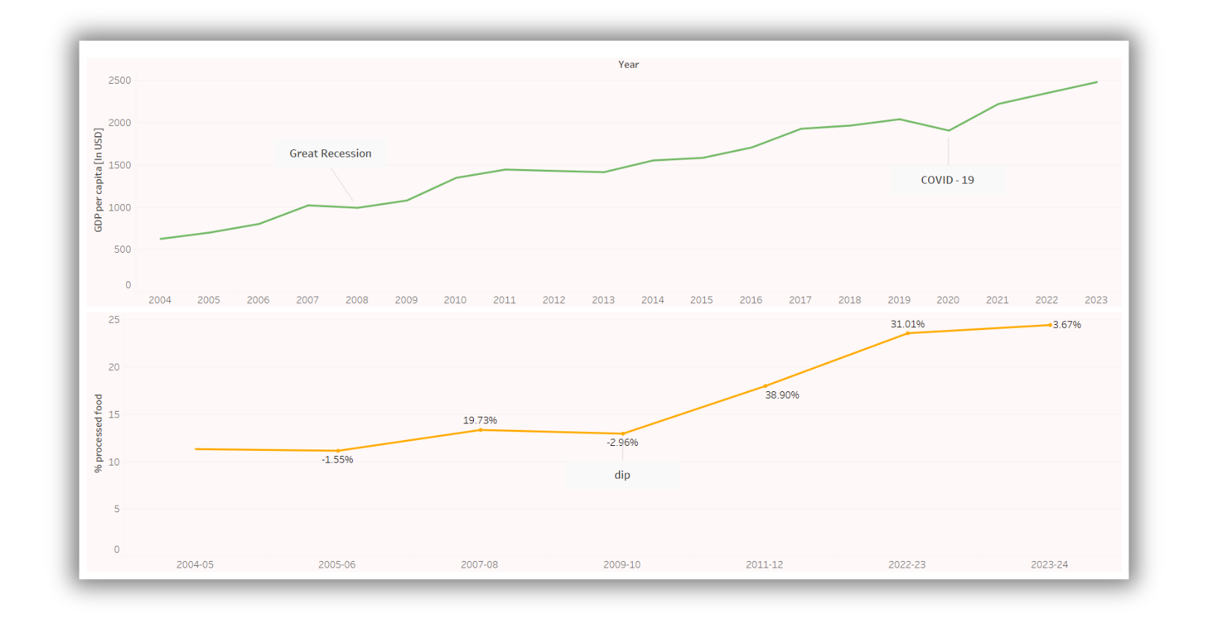
Tracking GDP and expenditure on processed food trends
Source : HCES and Google

Slide 22
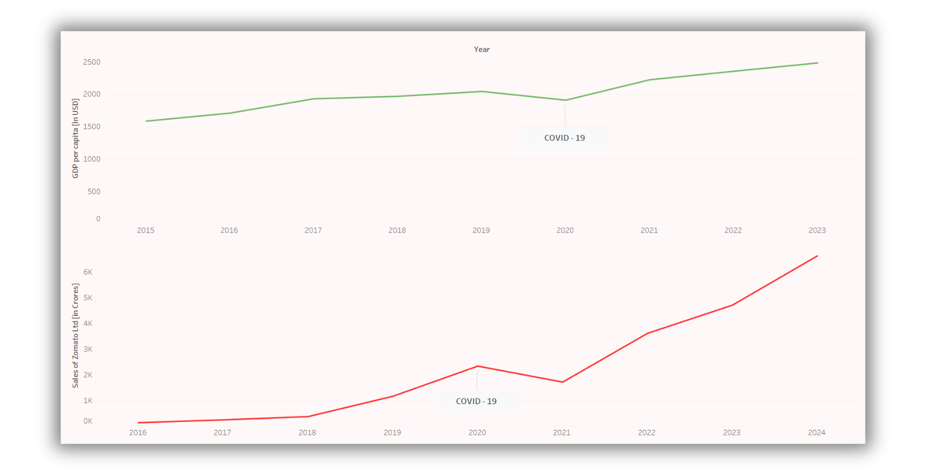
Tracking GDP & Zomato sales
Source : Screener and Google

Slide 23


Thank you

